Slide 1

Does Crypto Pay Out?
Authors: Cillian Dunne, Eoghan McGlinchey and Aakrit Shrestha
Demonstrator: Eoghan Cunningham
Date: 30/04/2021

Slide 2
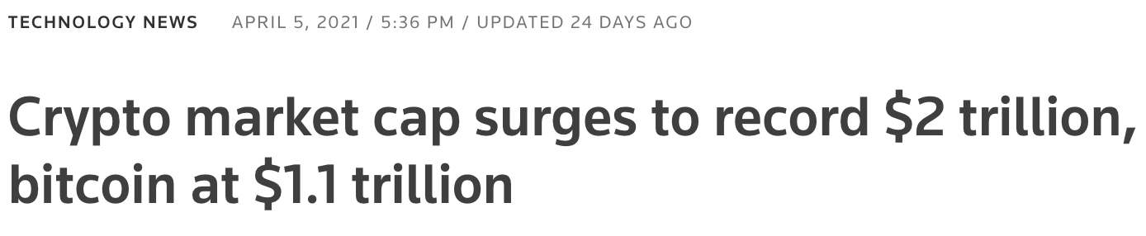
Motivation

Slide 3
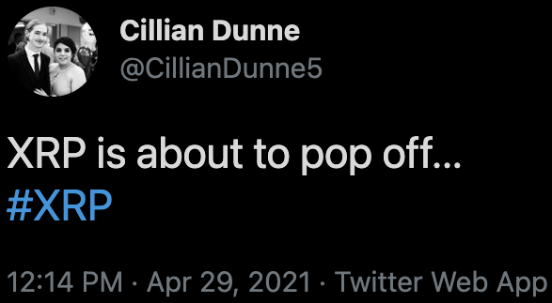
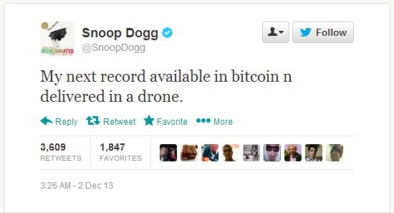
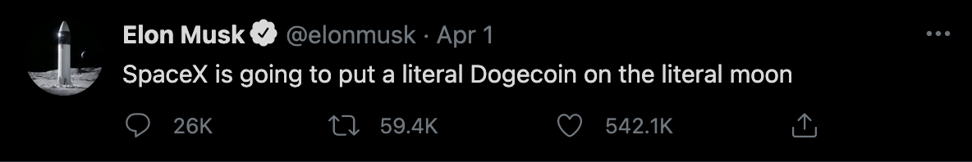
Motivation

Slide 4
Objectives
How do cryptos interact with each other? Is Bitcoin a trend setter?
Myth busting – Is crypto too volatile to invest in?
Covid’s effect on cryptos
Social media influence

Slide 5
This is all to ask…

Slide 6
Does Crypto Pay Out?
This is all to ask…

Slide 7
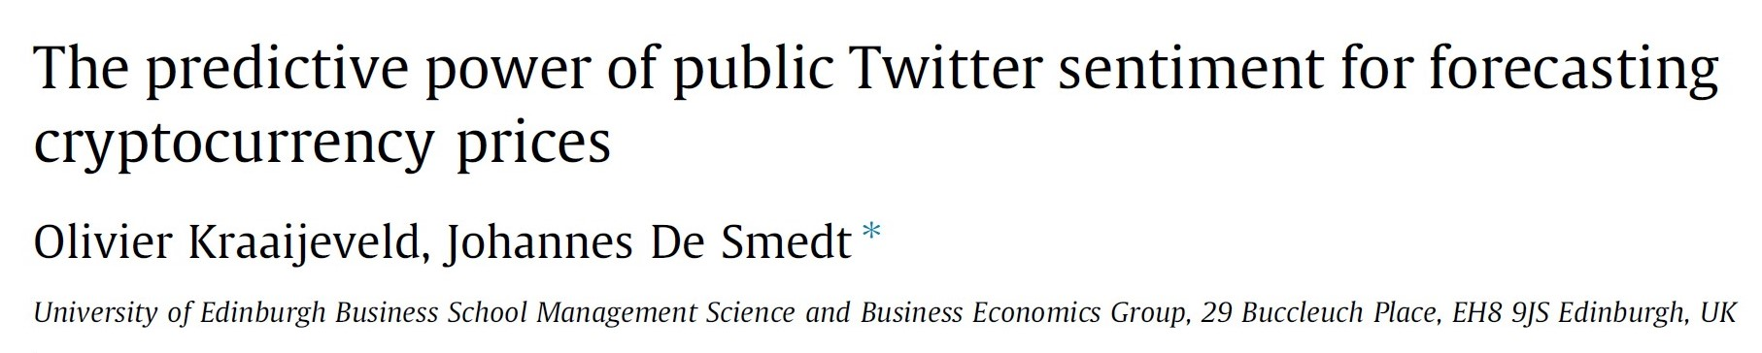
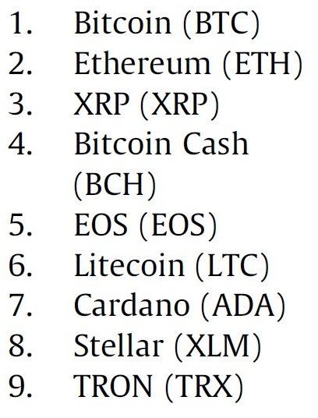
Related Work
limitations was the literature on twitter sentiment

Slide 8
Research Questions
RQ1: How much of an influence do the share prices of cryptocurrencies have on each other?(Eoghan)
Do the share prices of cryptocurrencies have any influence on each other?
Do the share prices of cryptocurrencies have any influence on each other a number of days later?
Which cryptocurrencies are most influential?
RQ2: Is it safer to invest in crypto short-term or long-term? (Cillian)
Can we find reoccurring trends?
Can we justify investing either strategies?
RQ3: Has Covid-19 influenced cryptocurrencies? (Cillian & Eoghan)
What differences can be observed? How have they been affected?
RQ4: Does social media influence cryptocurrency?
Do the Volume of tweets correlate to the price?
Can you spot trends with sentiment analysis?

Slide 9

Datasets and Data Collection
API key from cryptocompare.com
Historical data for 20 crypto currencies.
Clean.
Convert times from Epoch to UTC.
Twint Scrapping Twitter
Keyword search for 13 crypto currencies.
Extensive cleaning

Slide 10
RQ1: How much of an influence do the share prices of cryptocurrencies have on each other?(Eoghan)

Slide 11
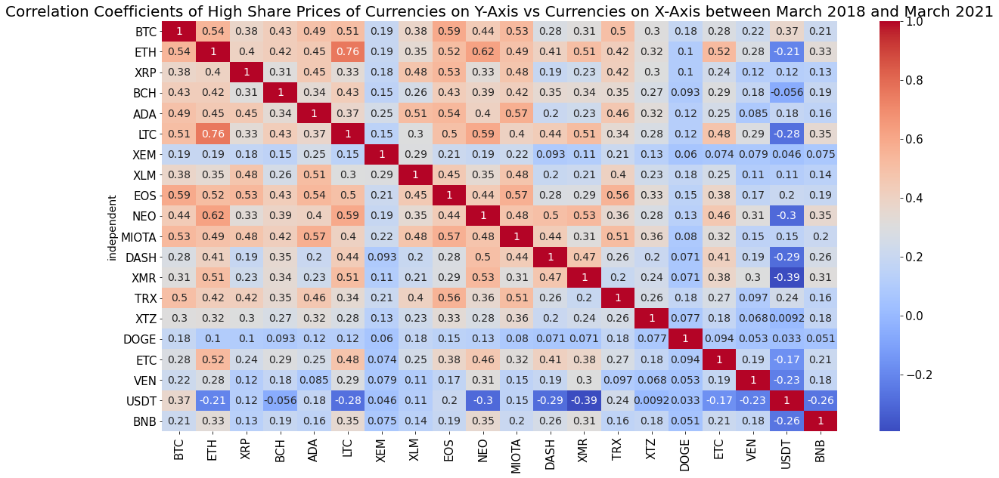

Slide 14
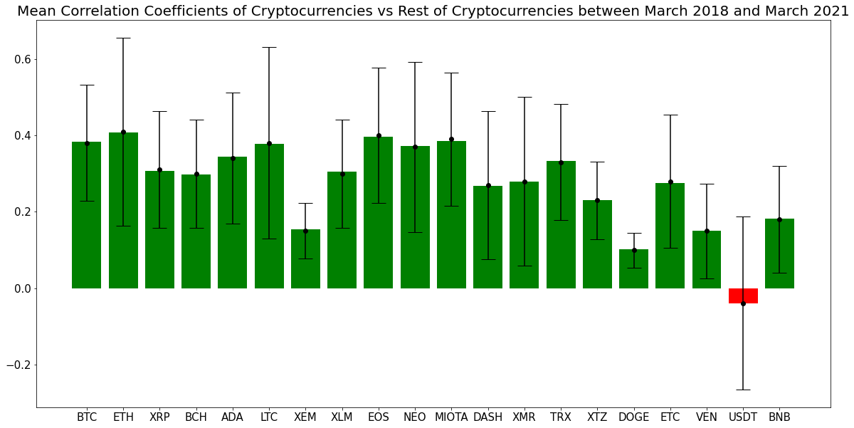

Slide 15


Slide 16
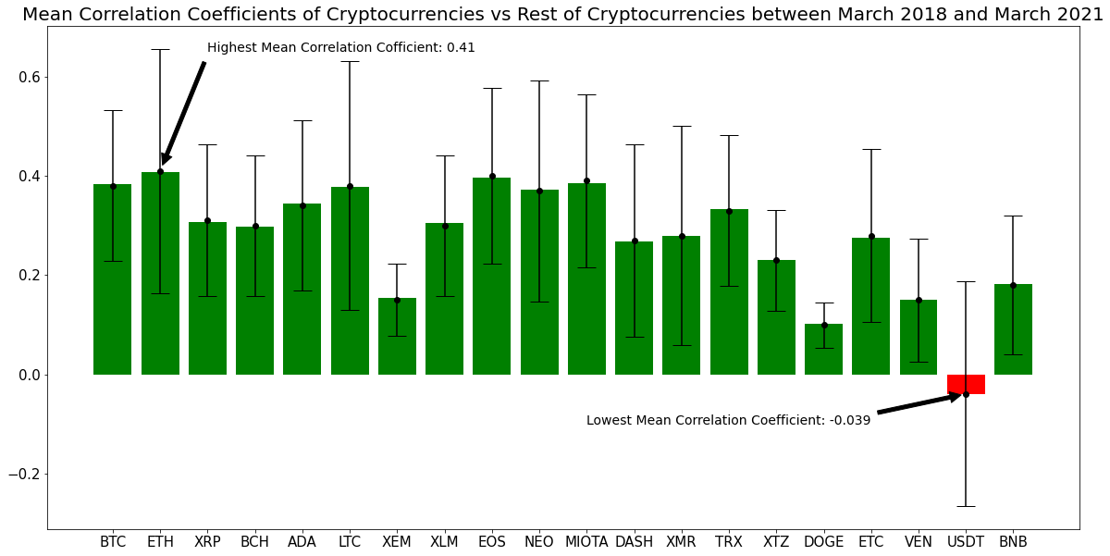

Slide 17


Slide 18
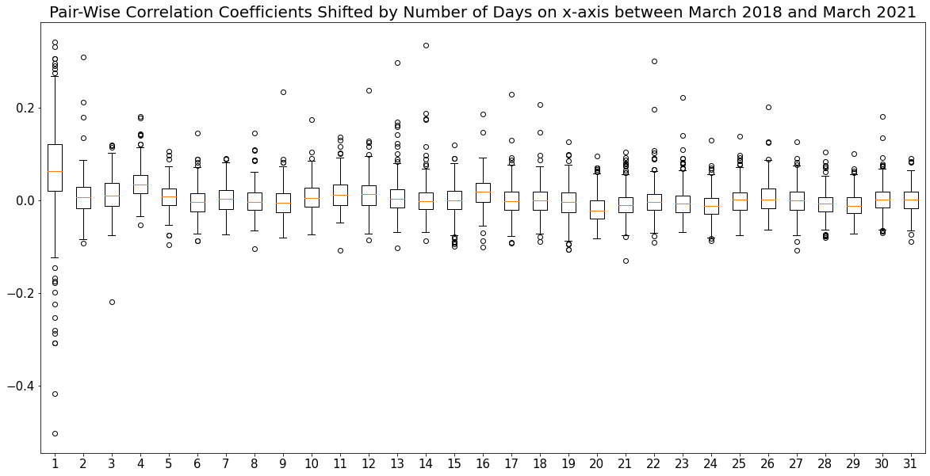

Slide 19
RQ2: Is it safer to invest in crypto short-term or long-term? (Cillian)

Slide 20
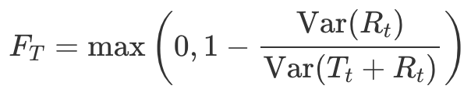
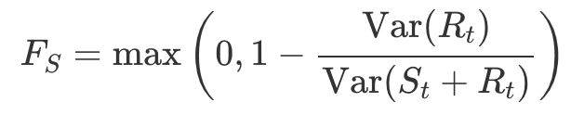
Methodology
F_{T} : strength of the trend,
F_{S} : strength of the seasonality,
T_{T} : smoothed trend component,
S_{T} : seasonal component,
R_{T} : remainder component

Slide 21
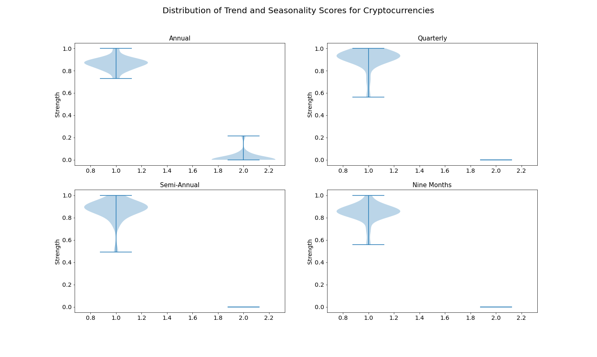

Slide 22
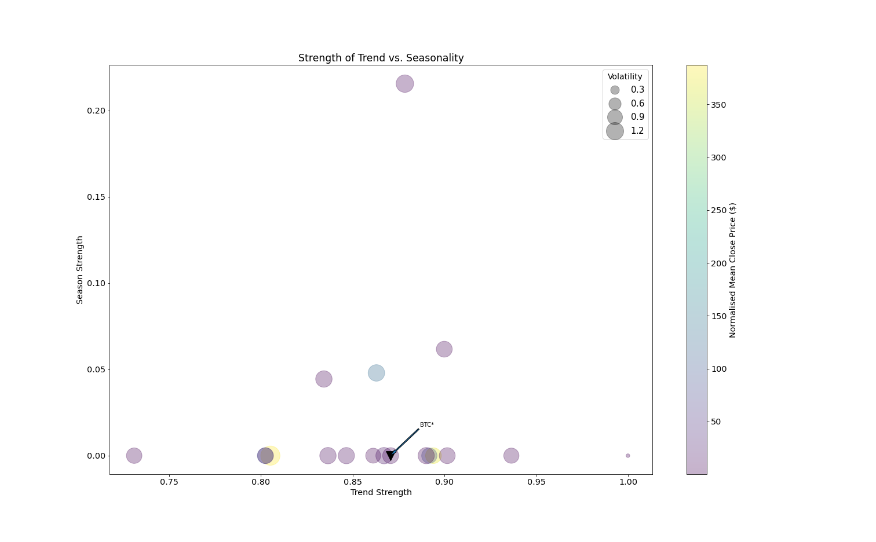

Slide 23
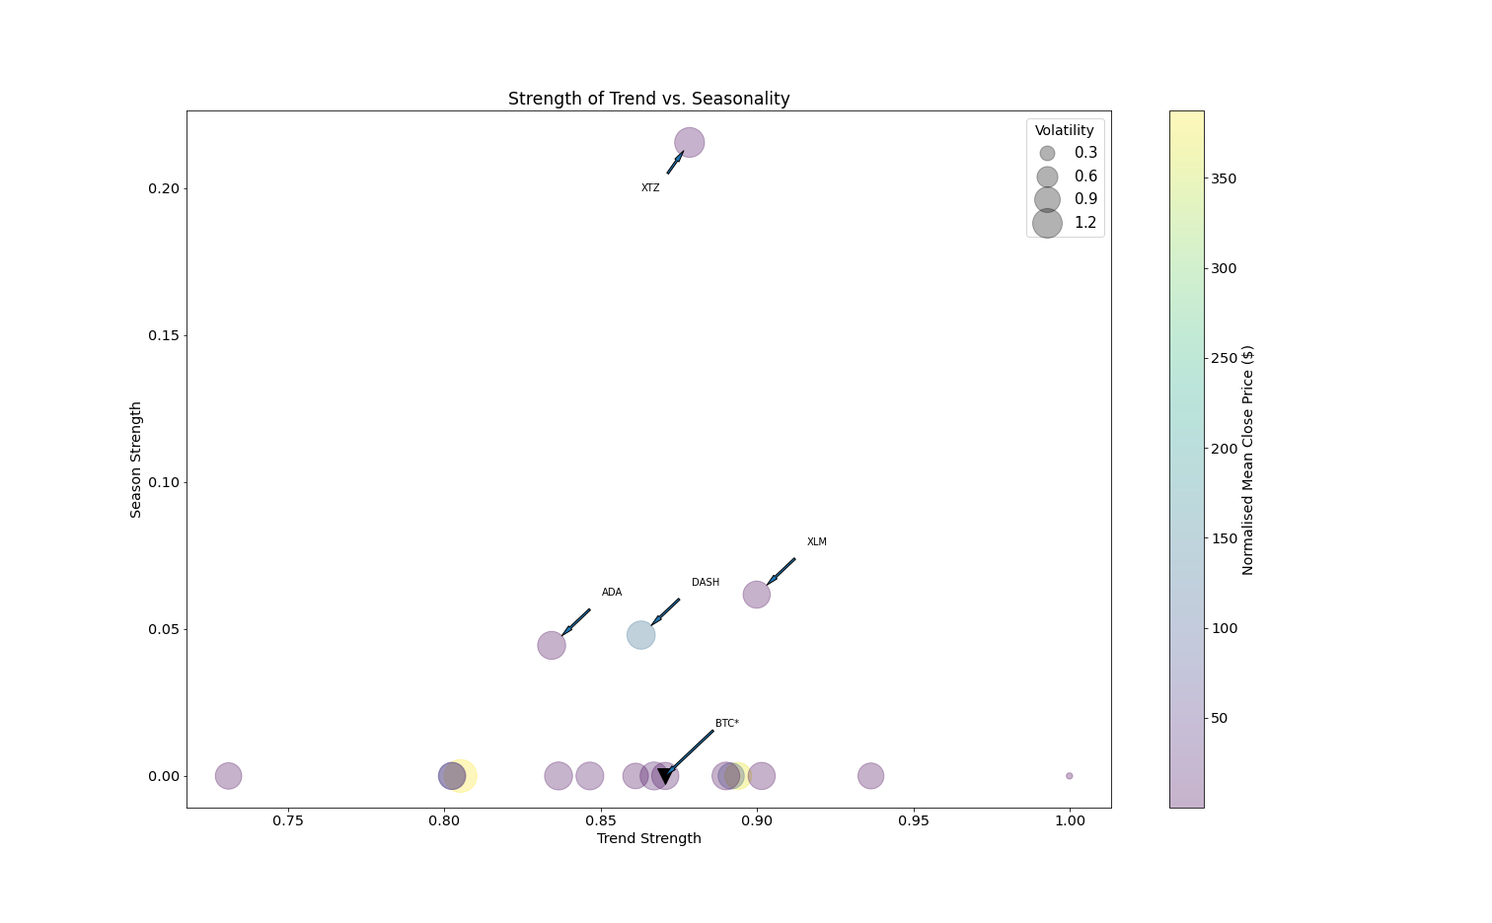

Slide 24


Slide 25
RQ3: Has Covid-19 influenced cryptocurrencies? (Cillian & Eoghan)

Slide 26
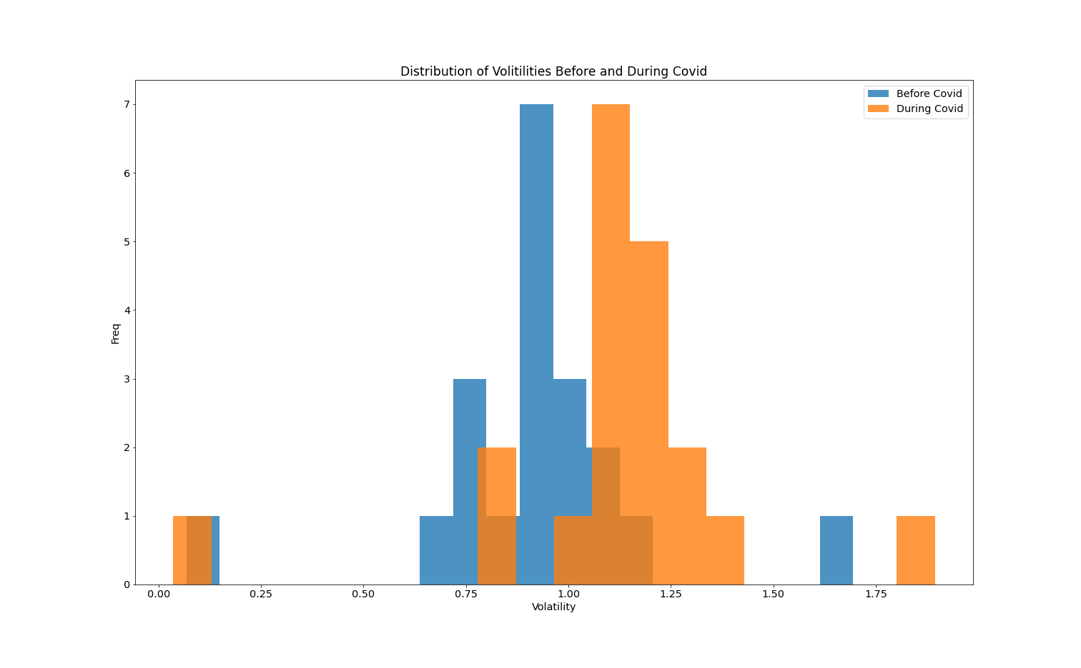

Slide 27
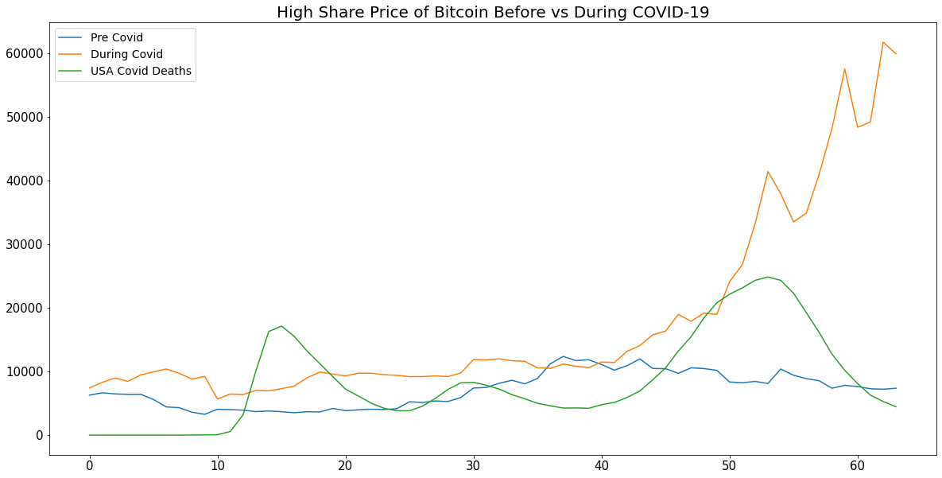

Slide 28
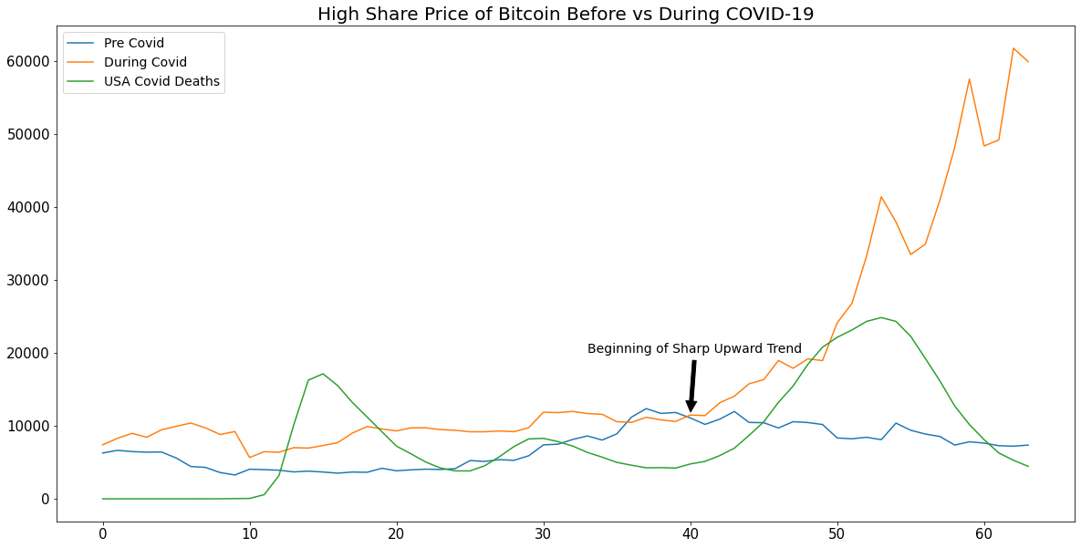

Slide 29
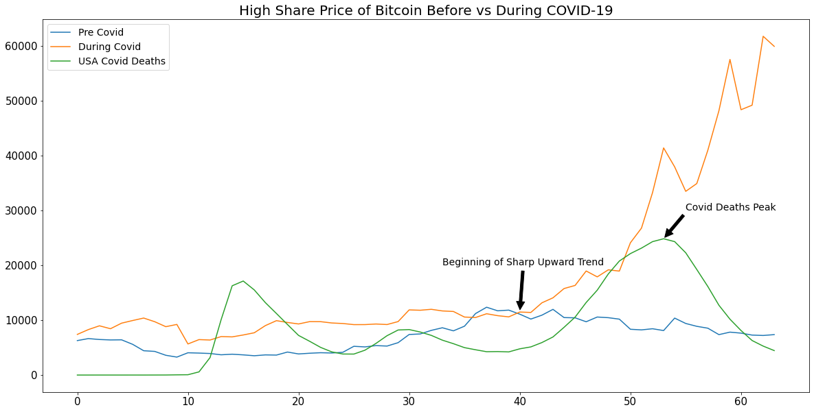

Slide 30
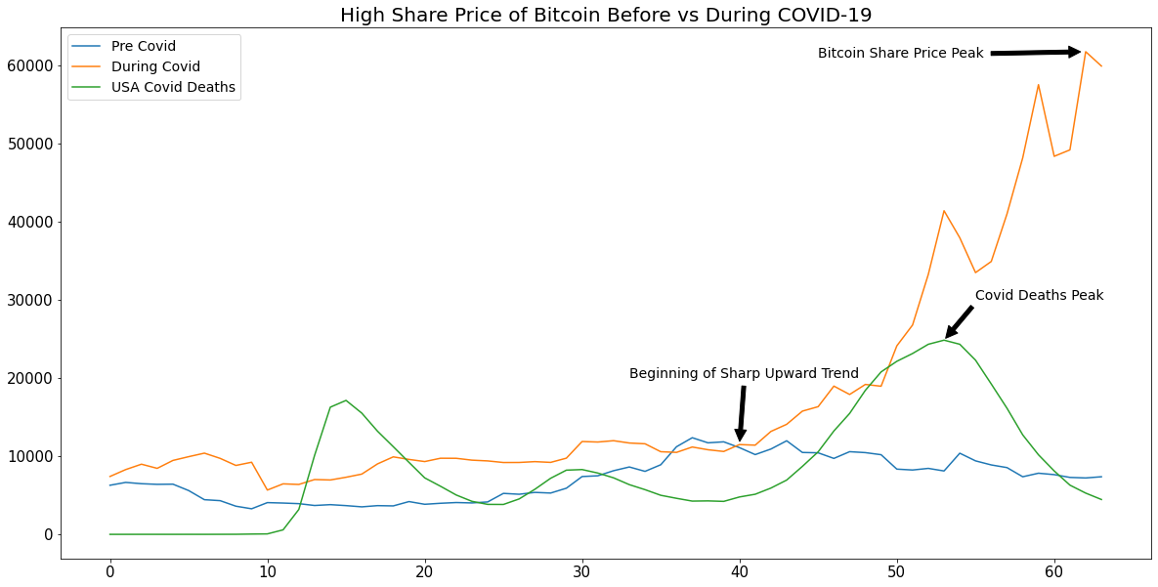

Slide 31
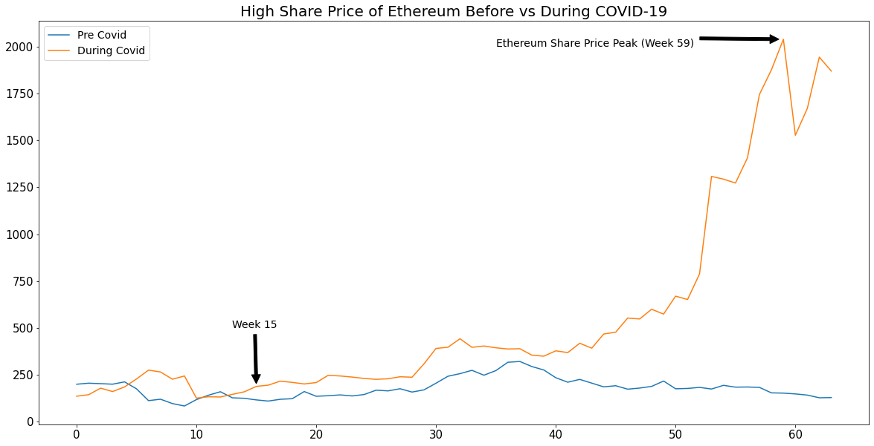
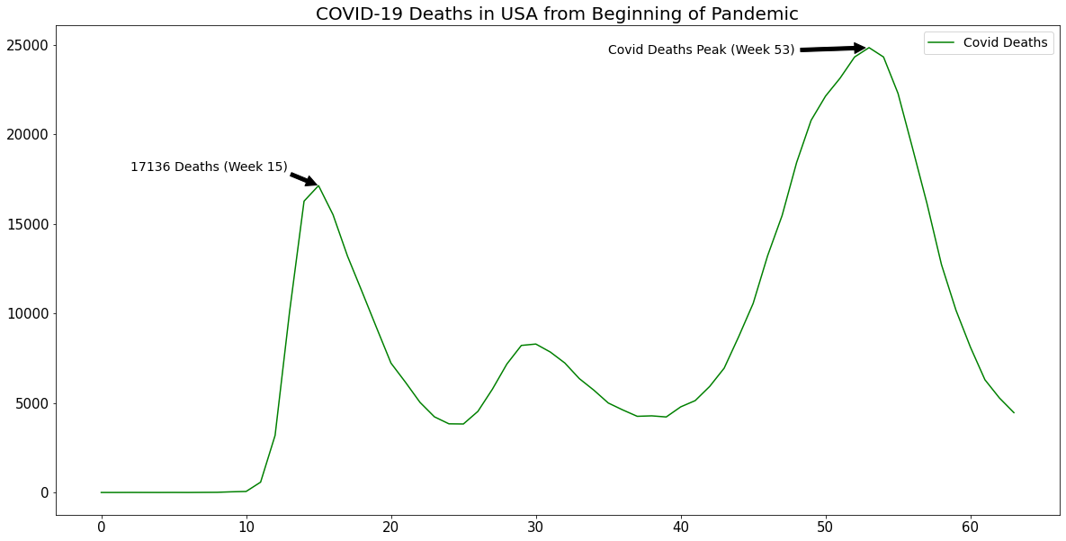

Slide 32
RQ4: Does social media influence cryptocurrency? (Aakrit)

Slide 33
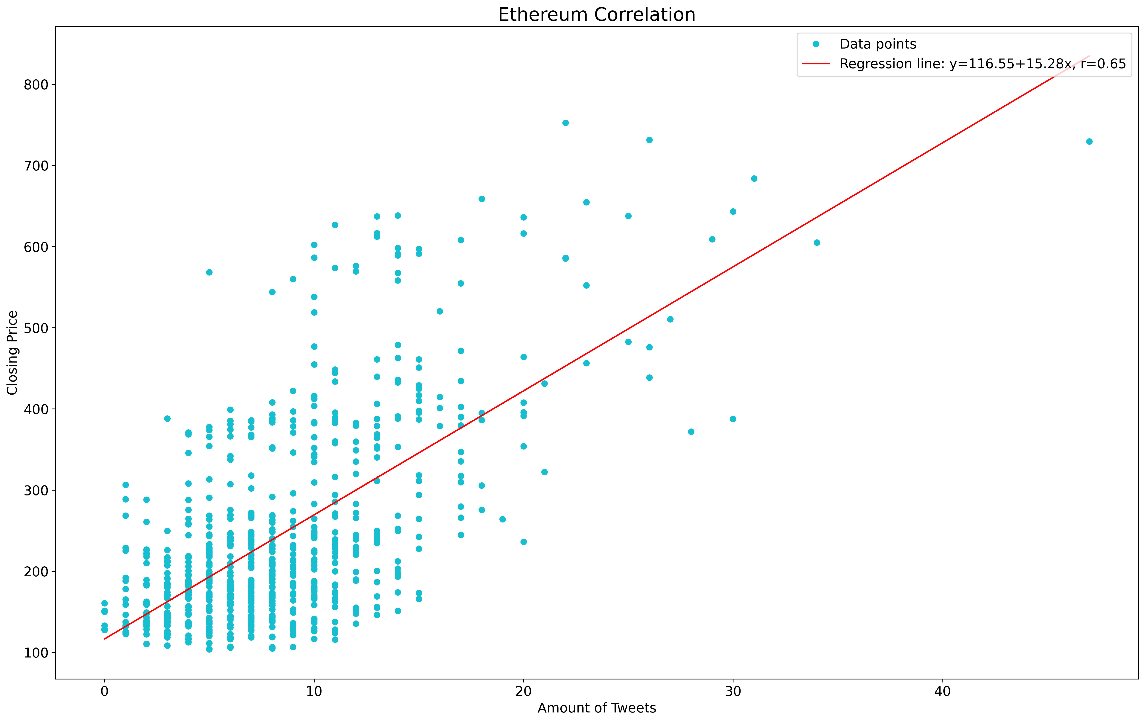

Slide 34
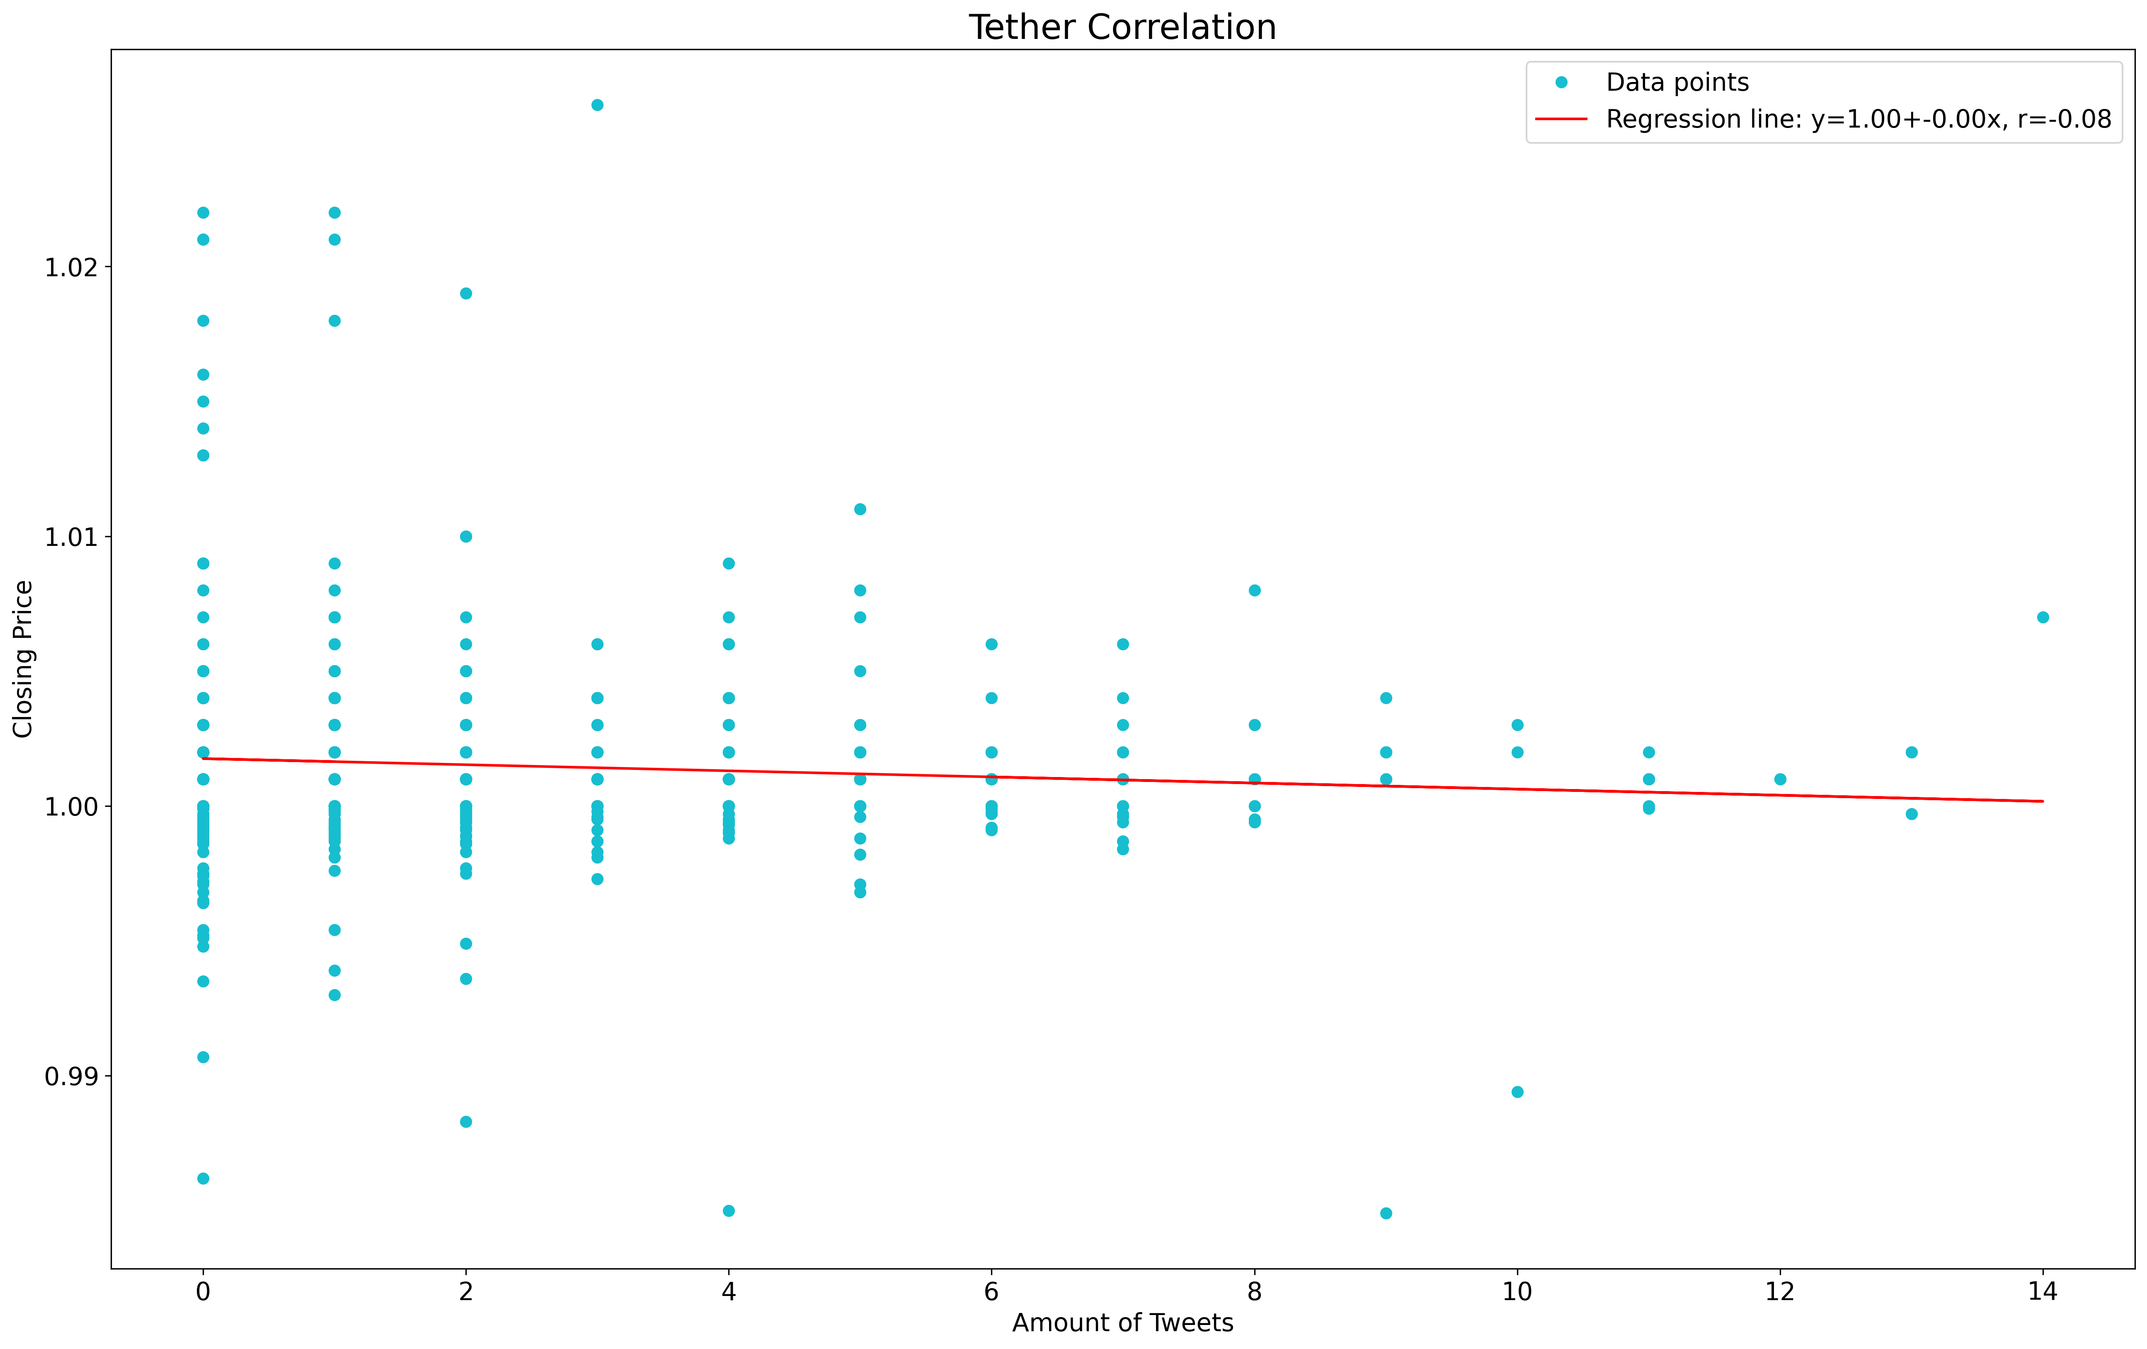

Slide 35
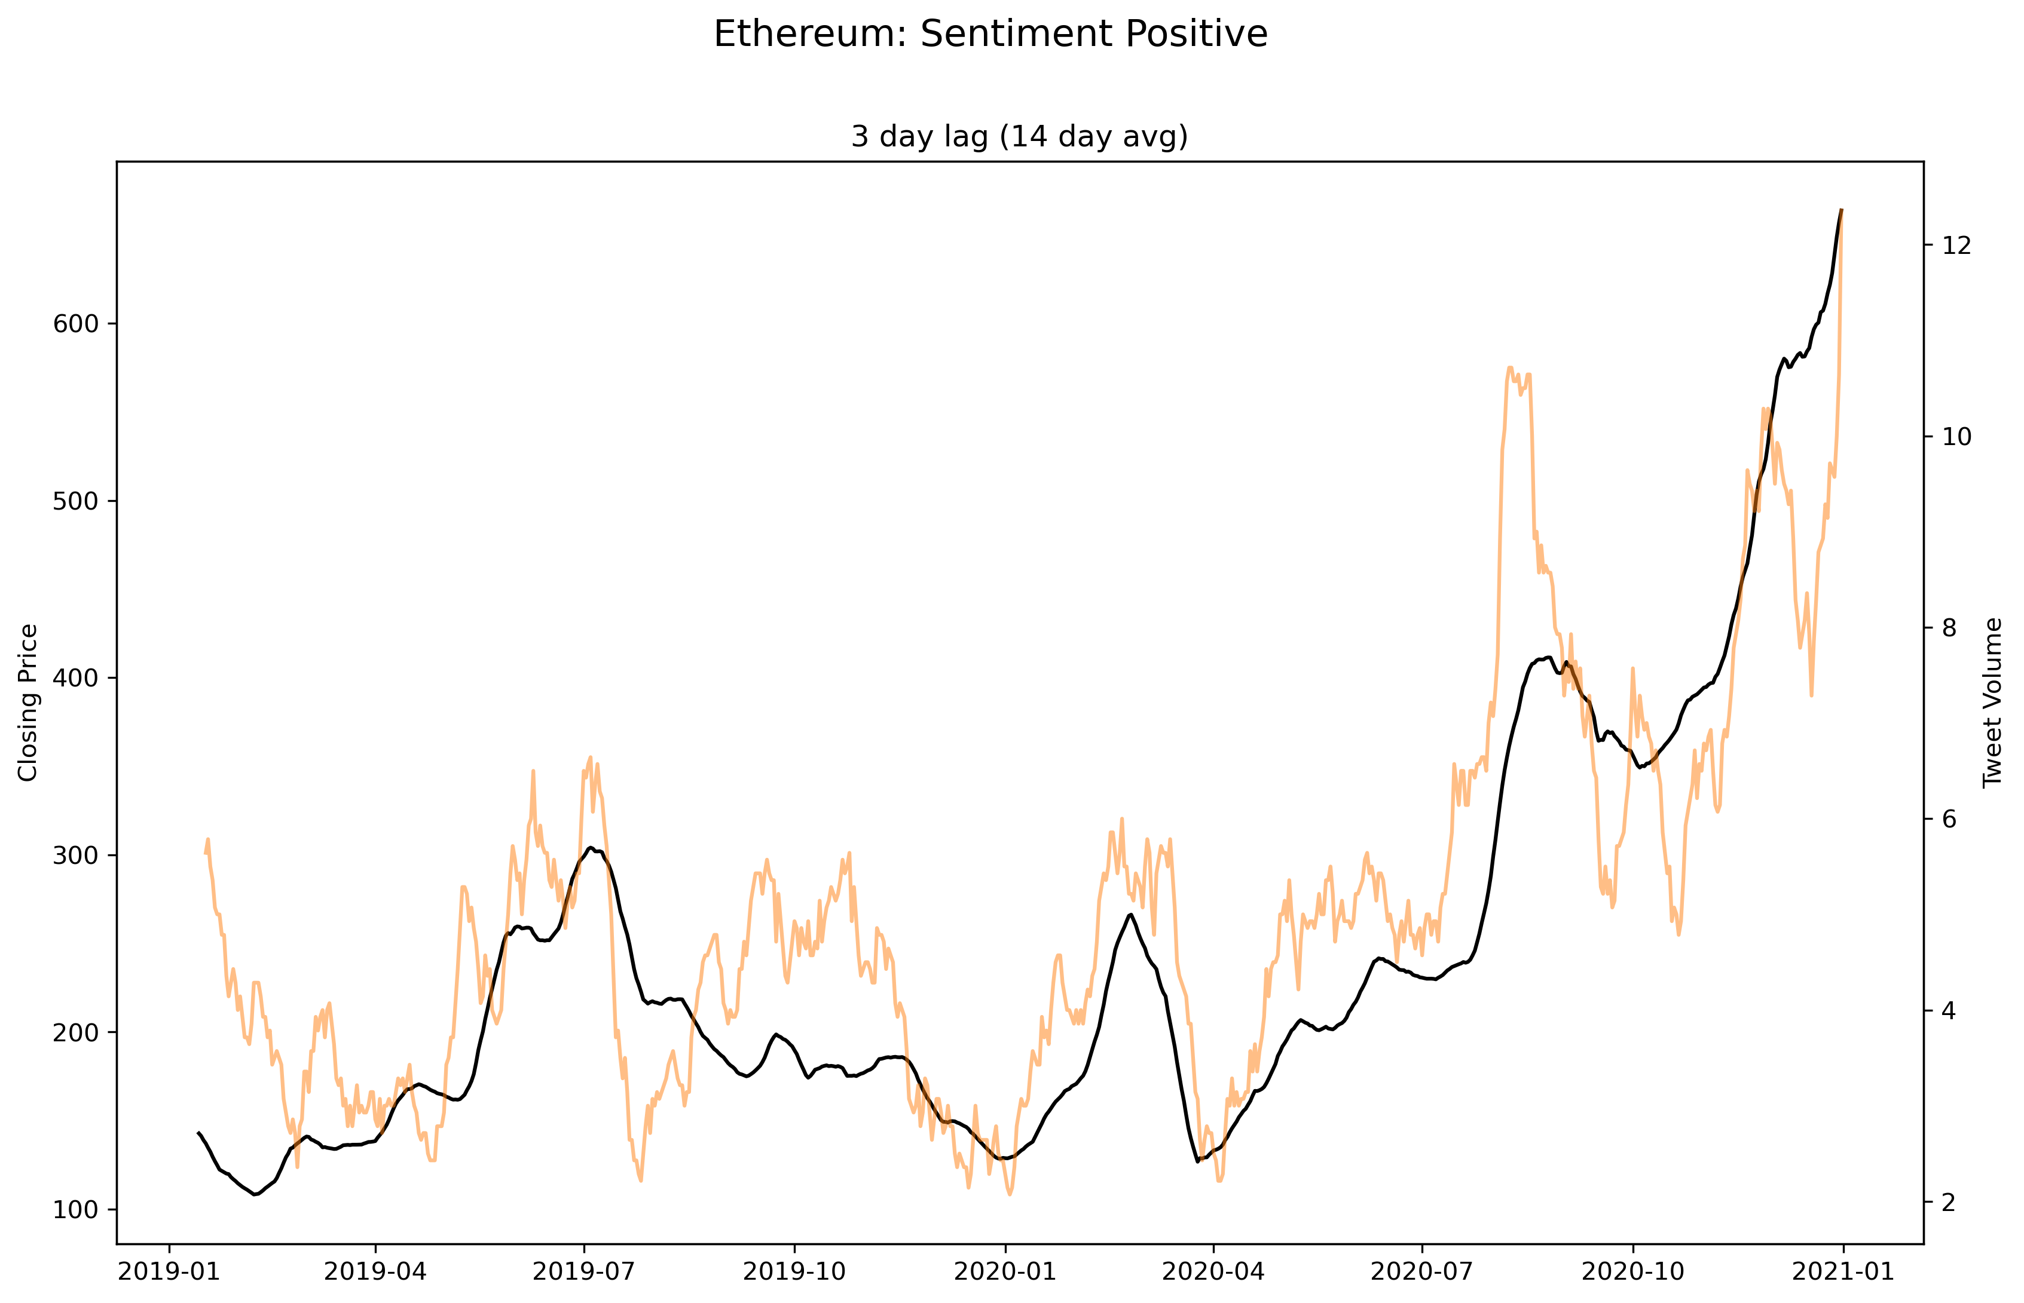

Slide 36
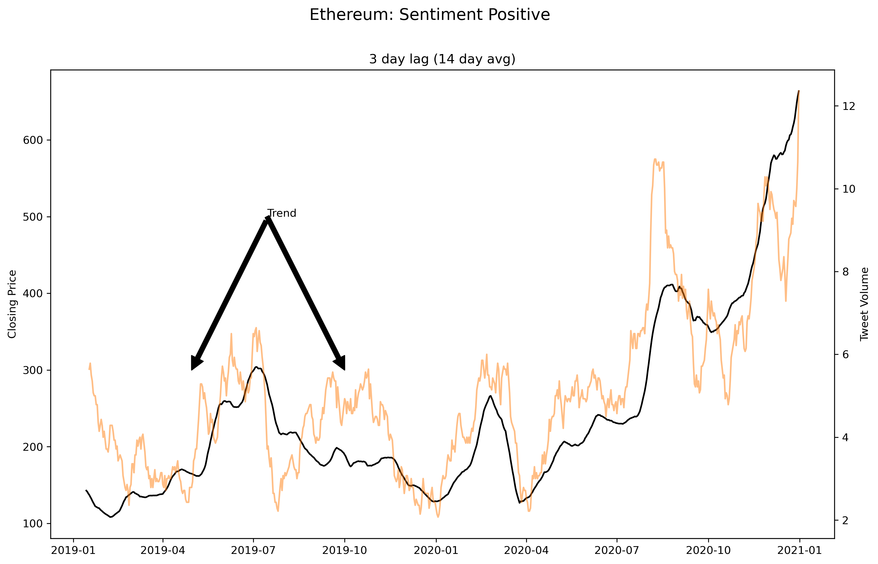

Slide 37
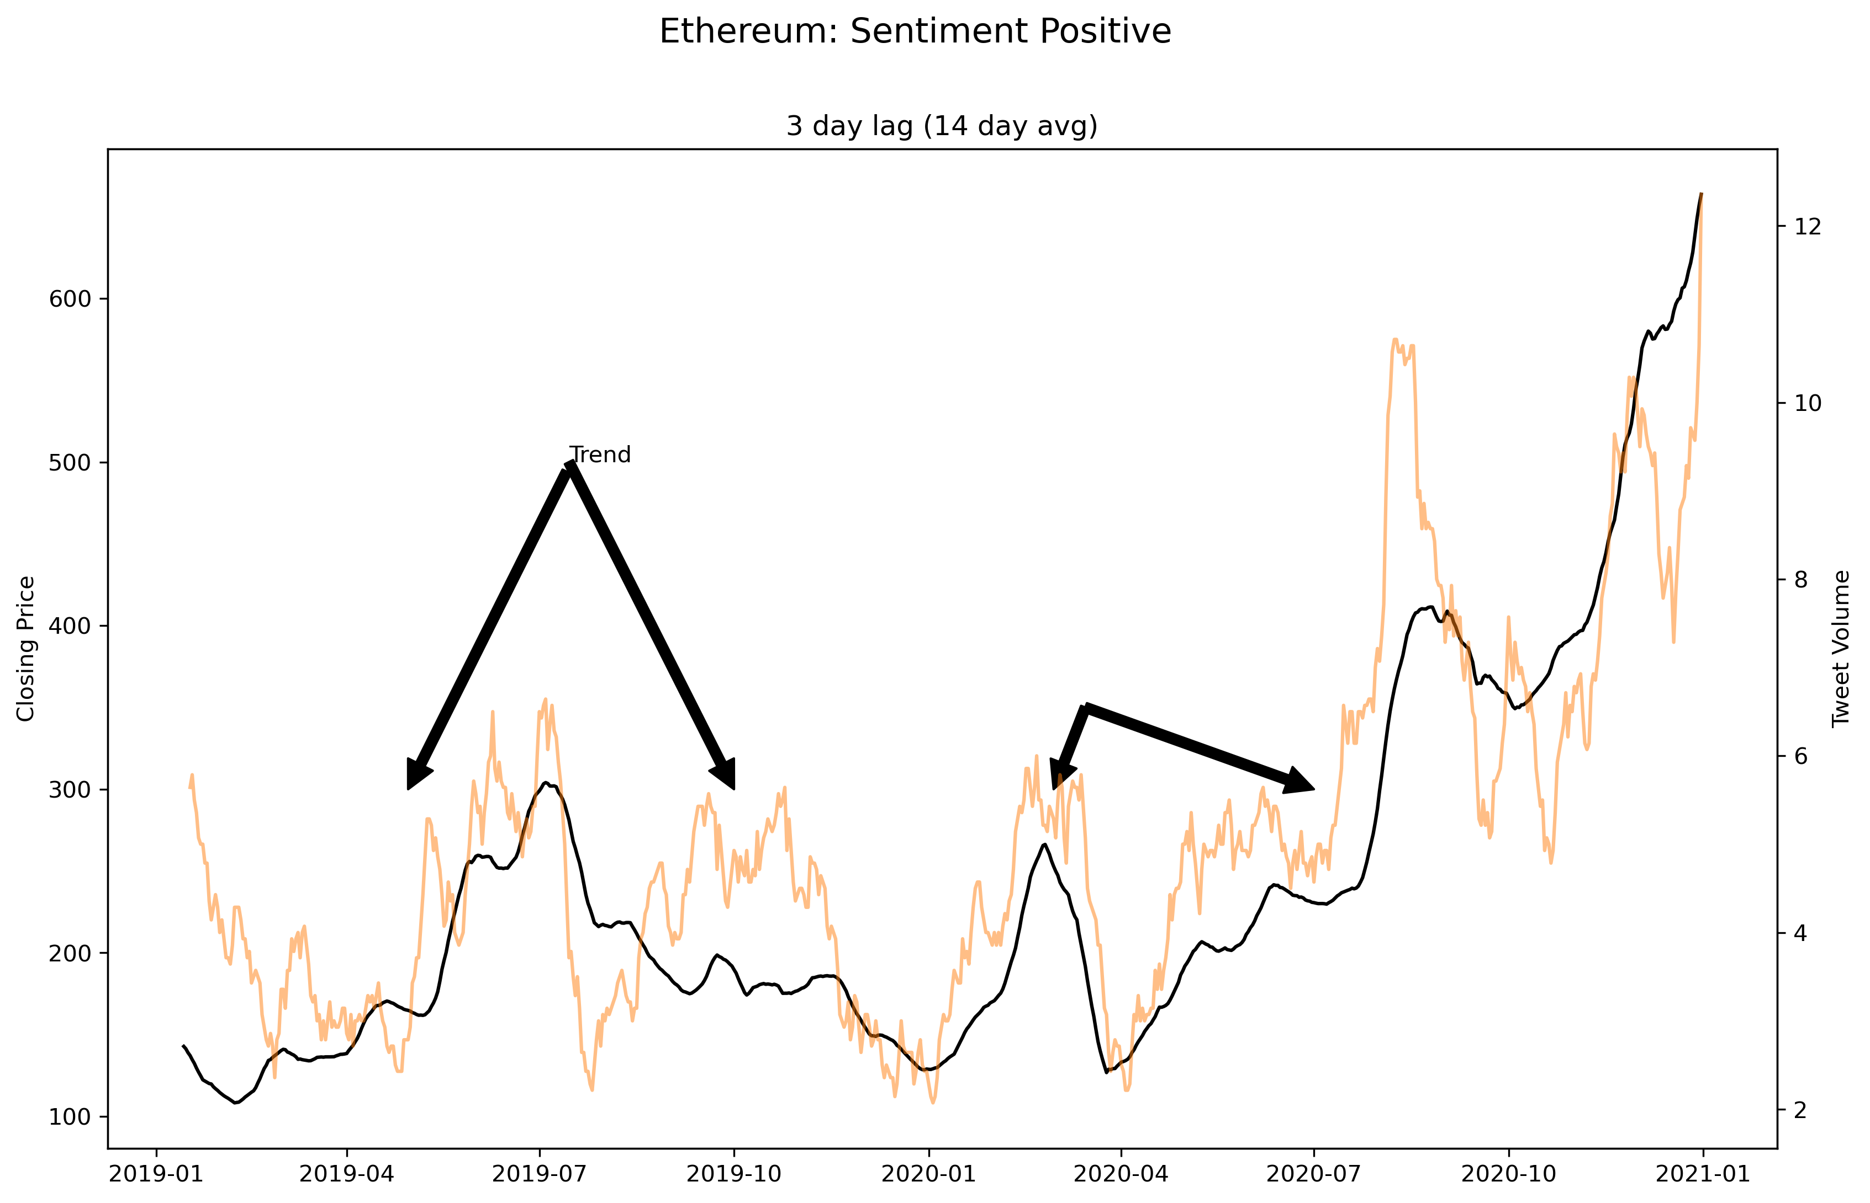

Slide 38
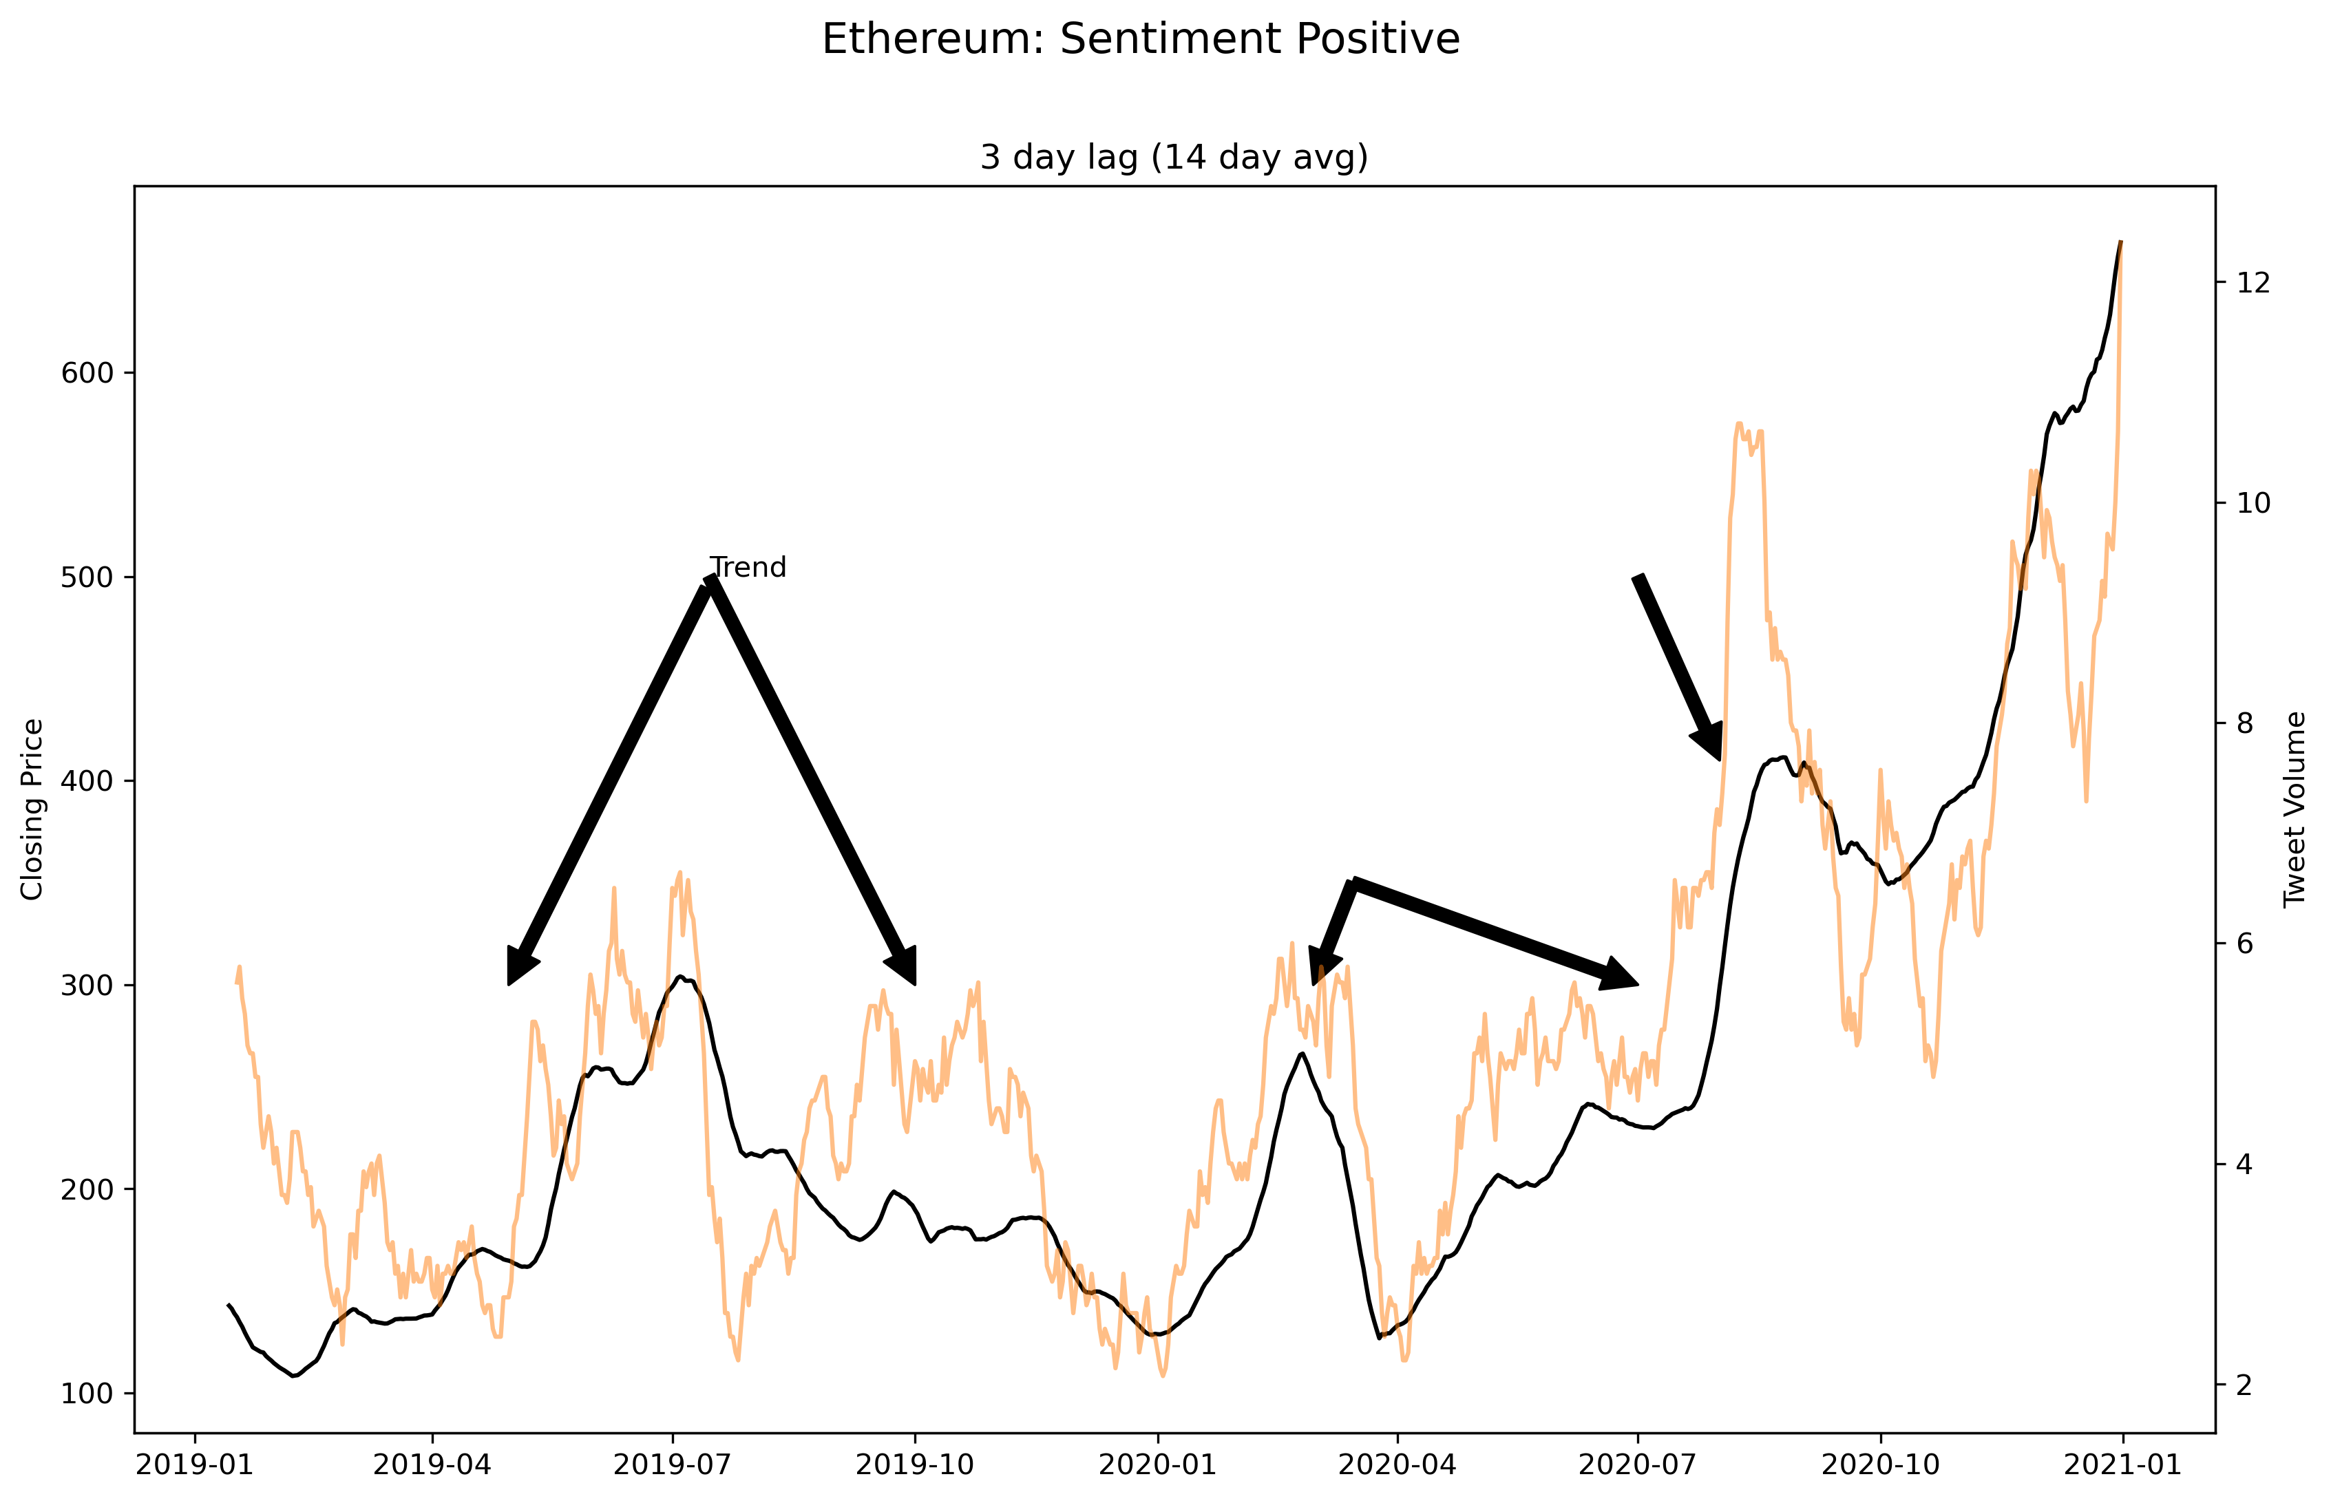

Slide 39
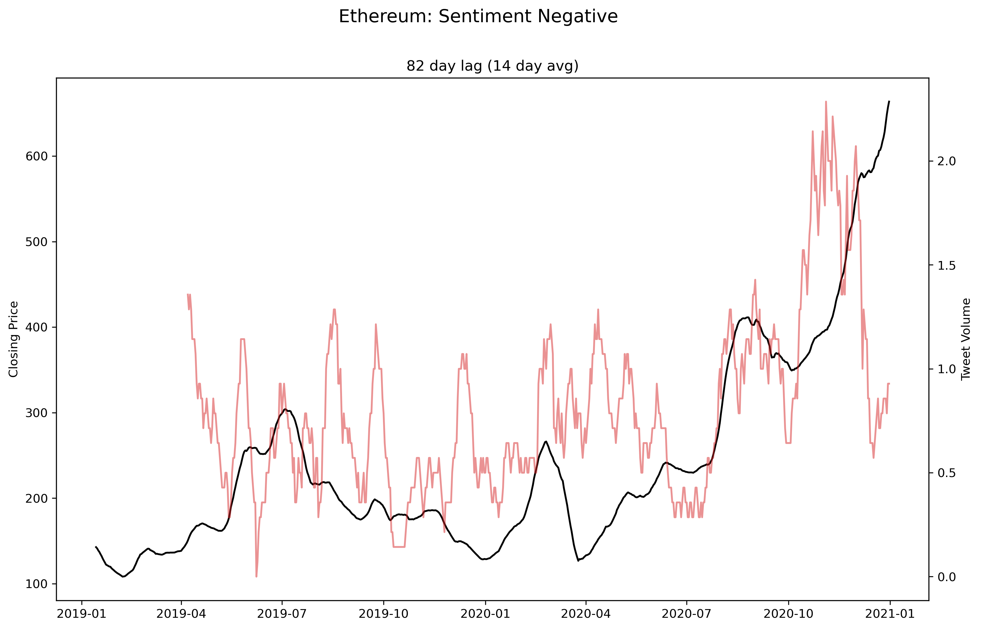

Slide 40
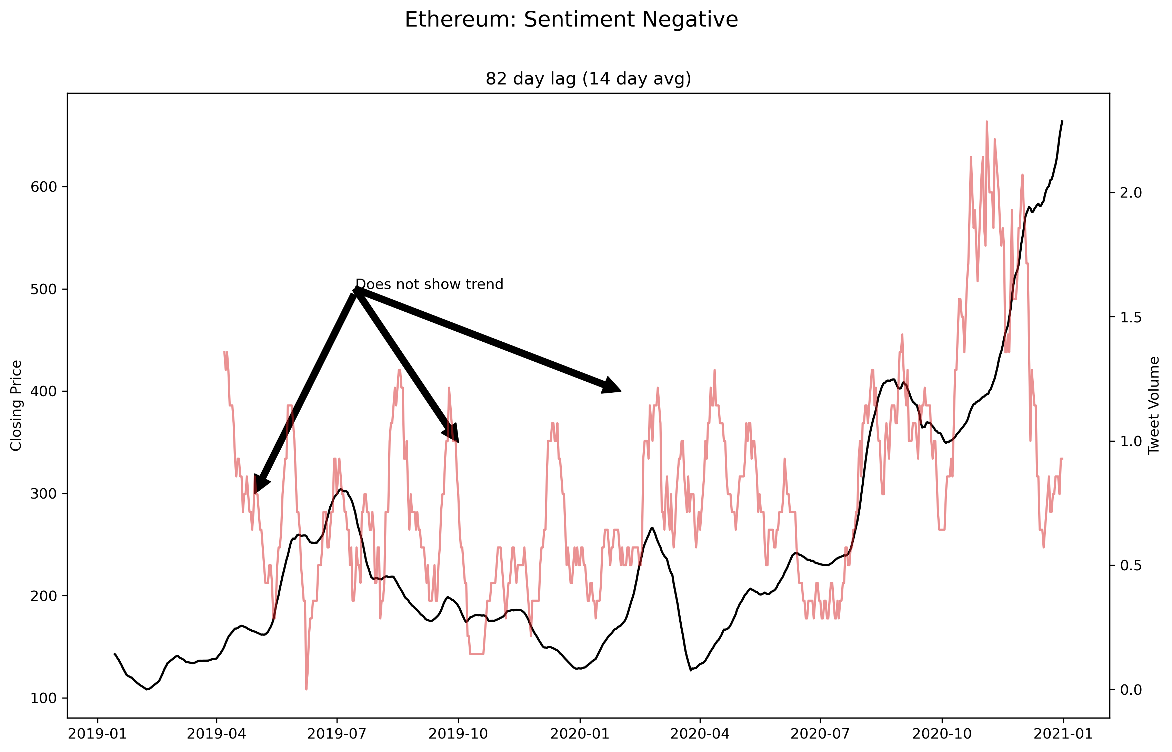

Slide 41
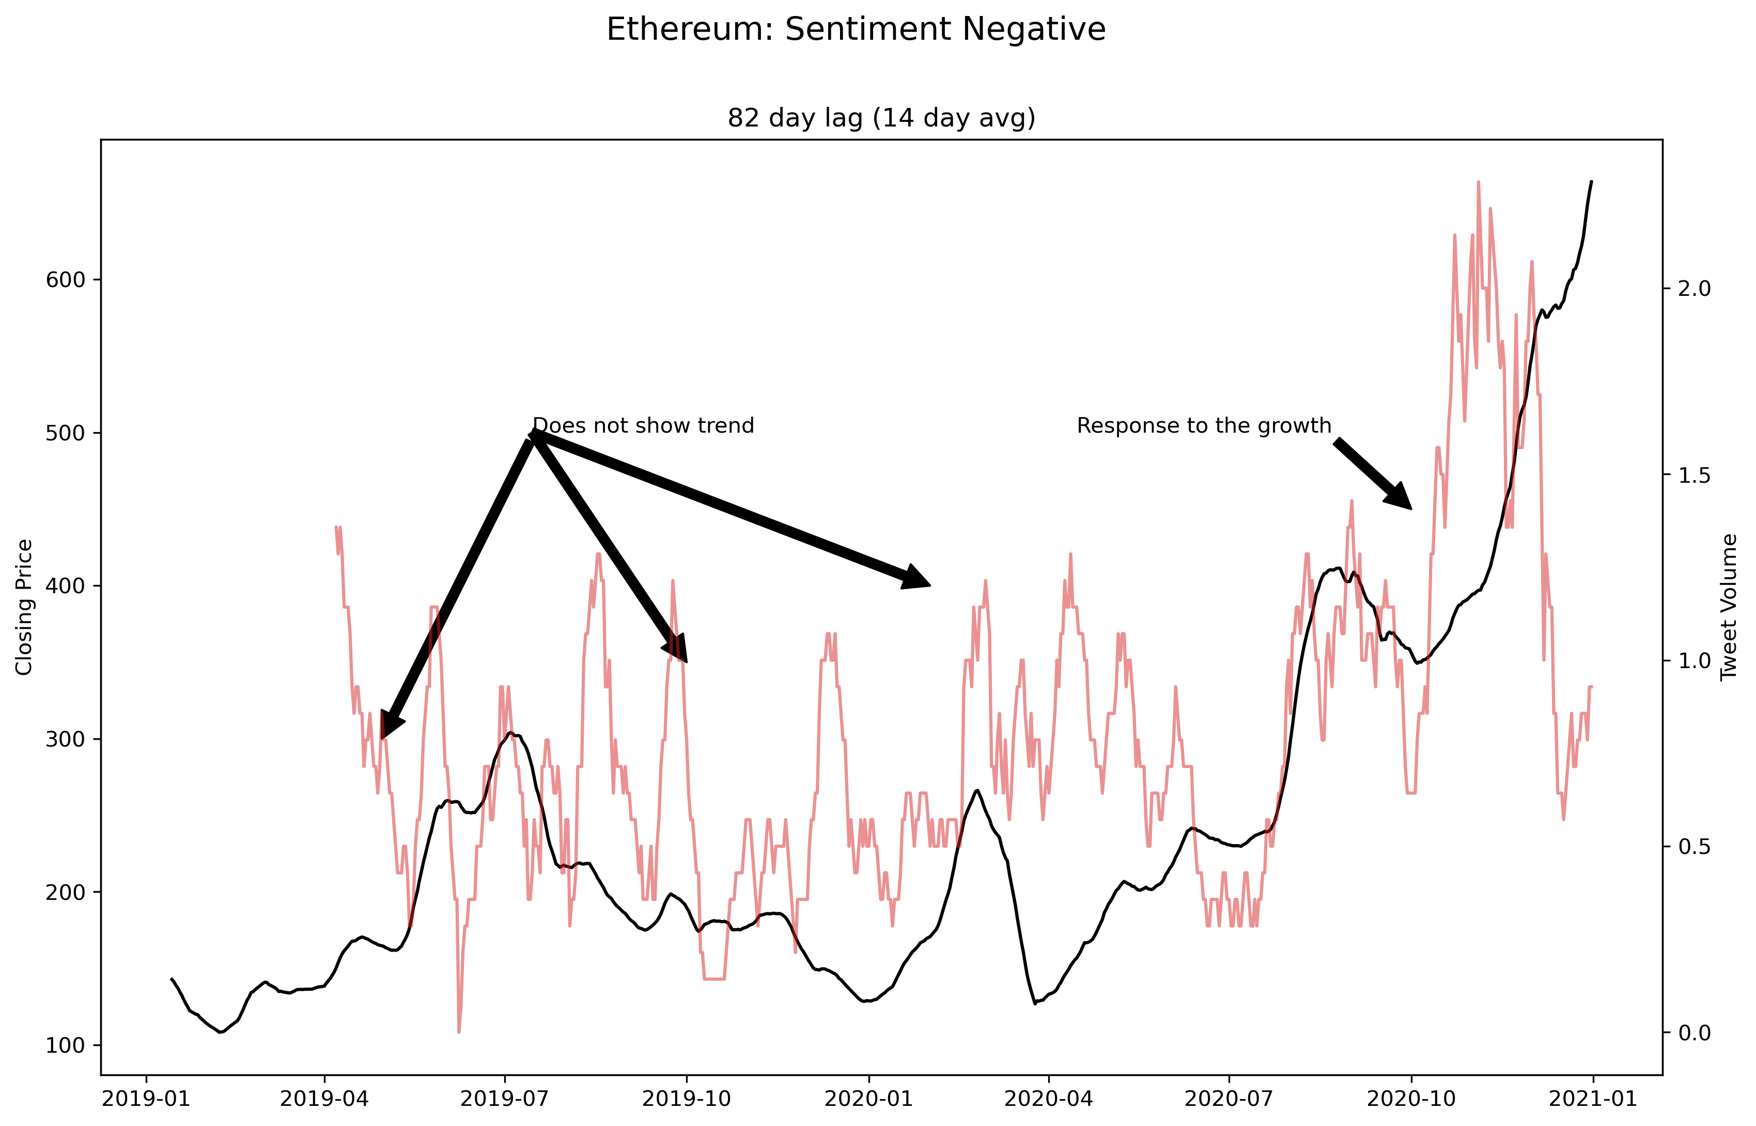

Slide 42
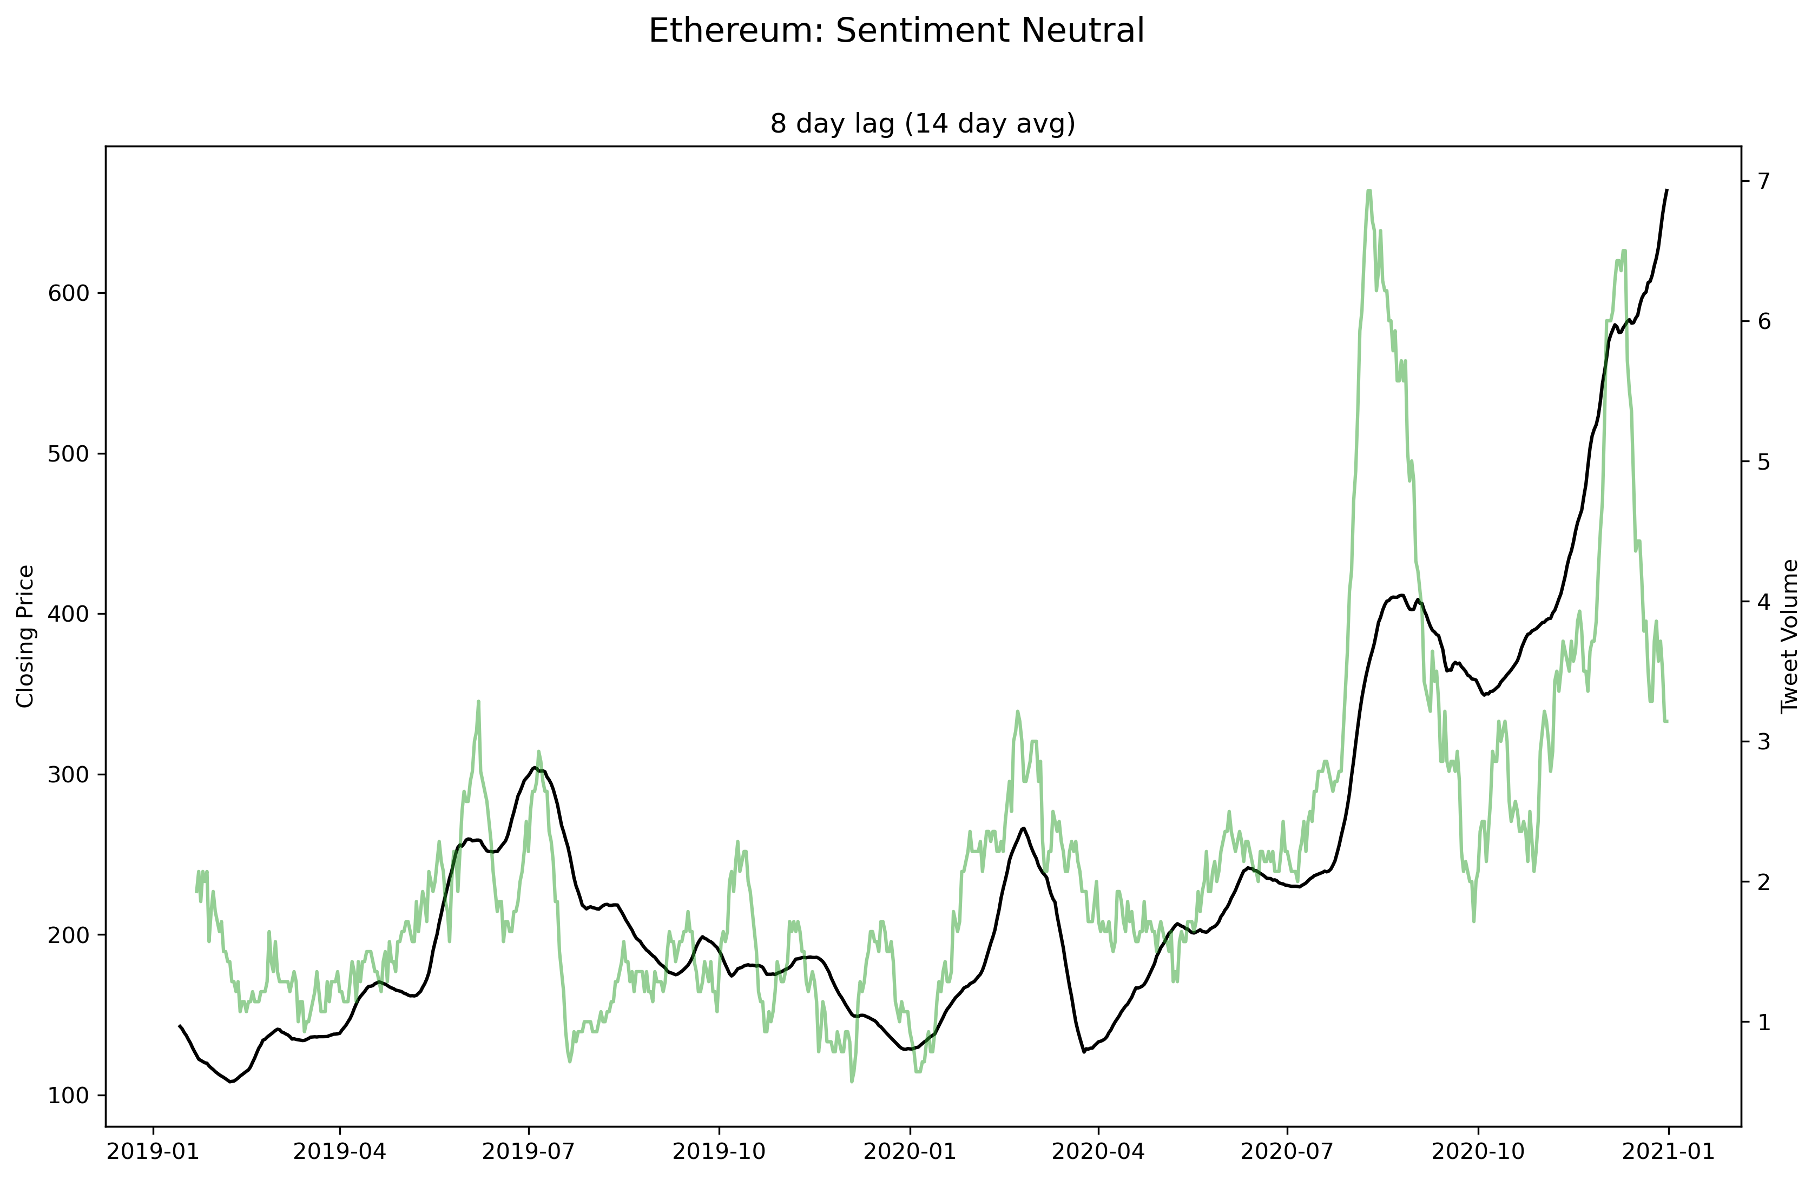

Slide 43
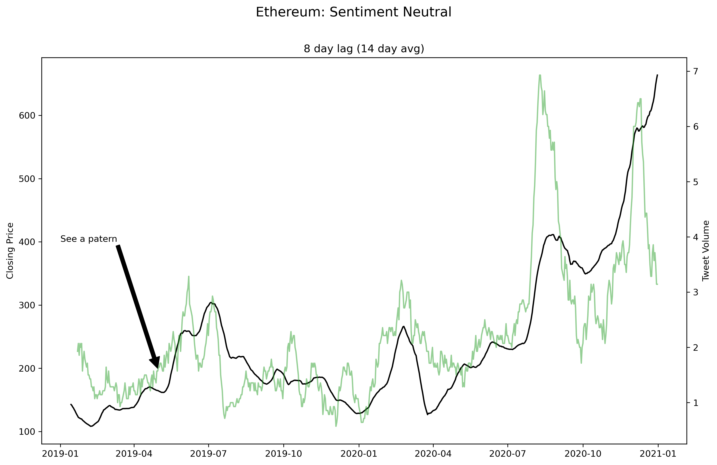

Slide 44
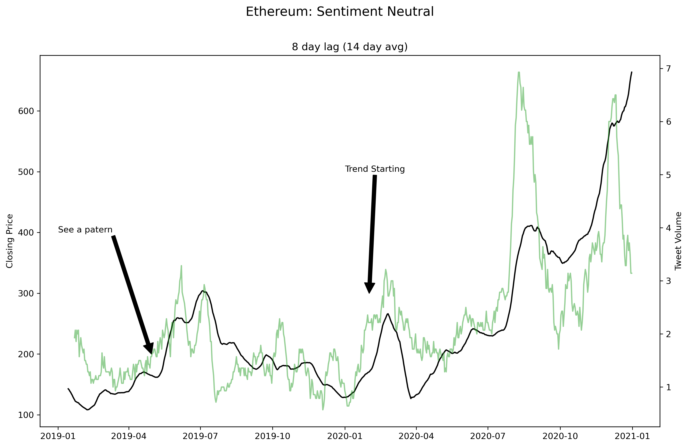

Slide 45
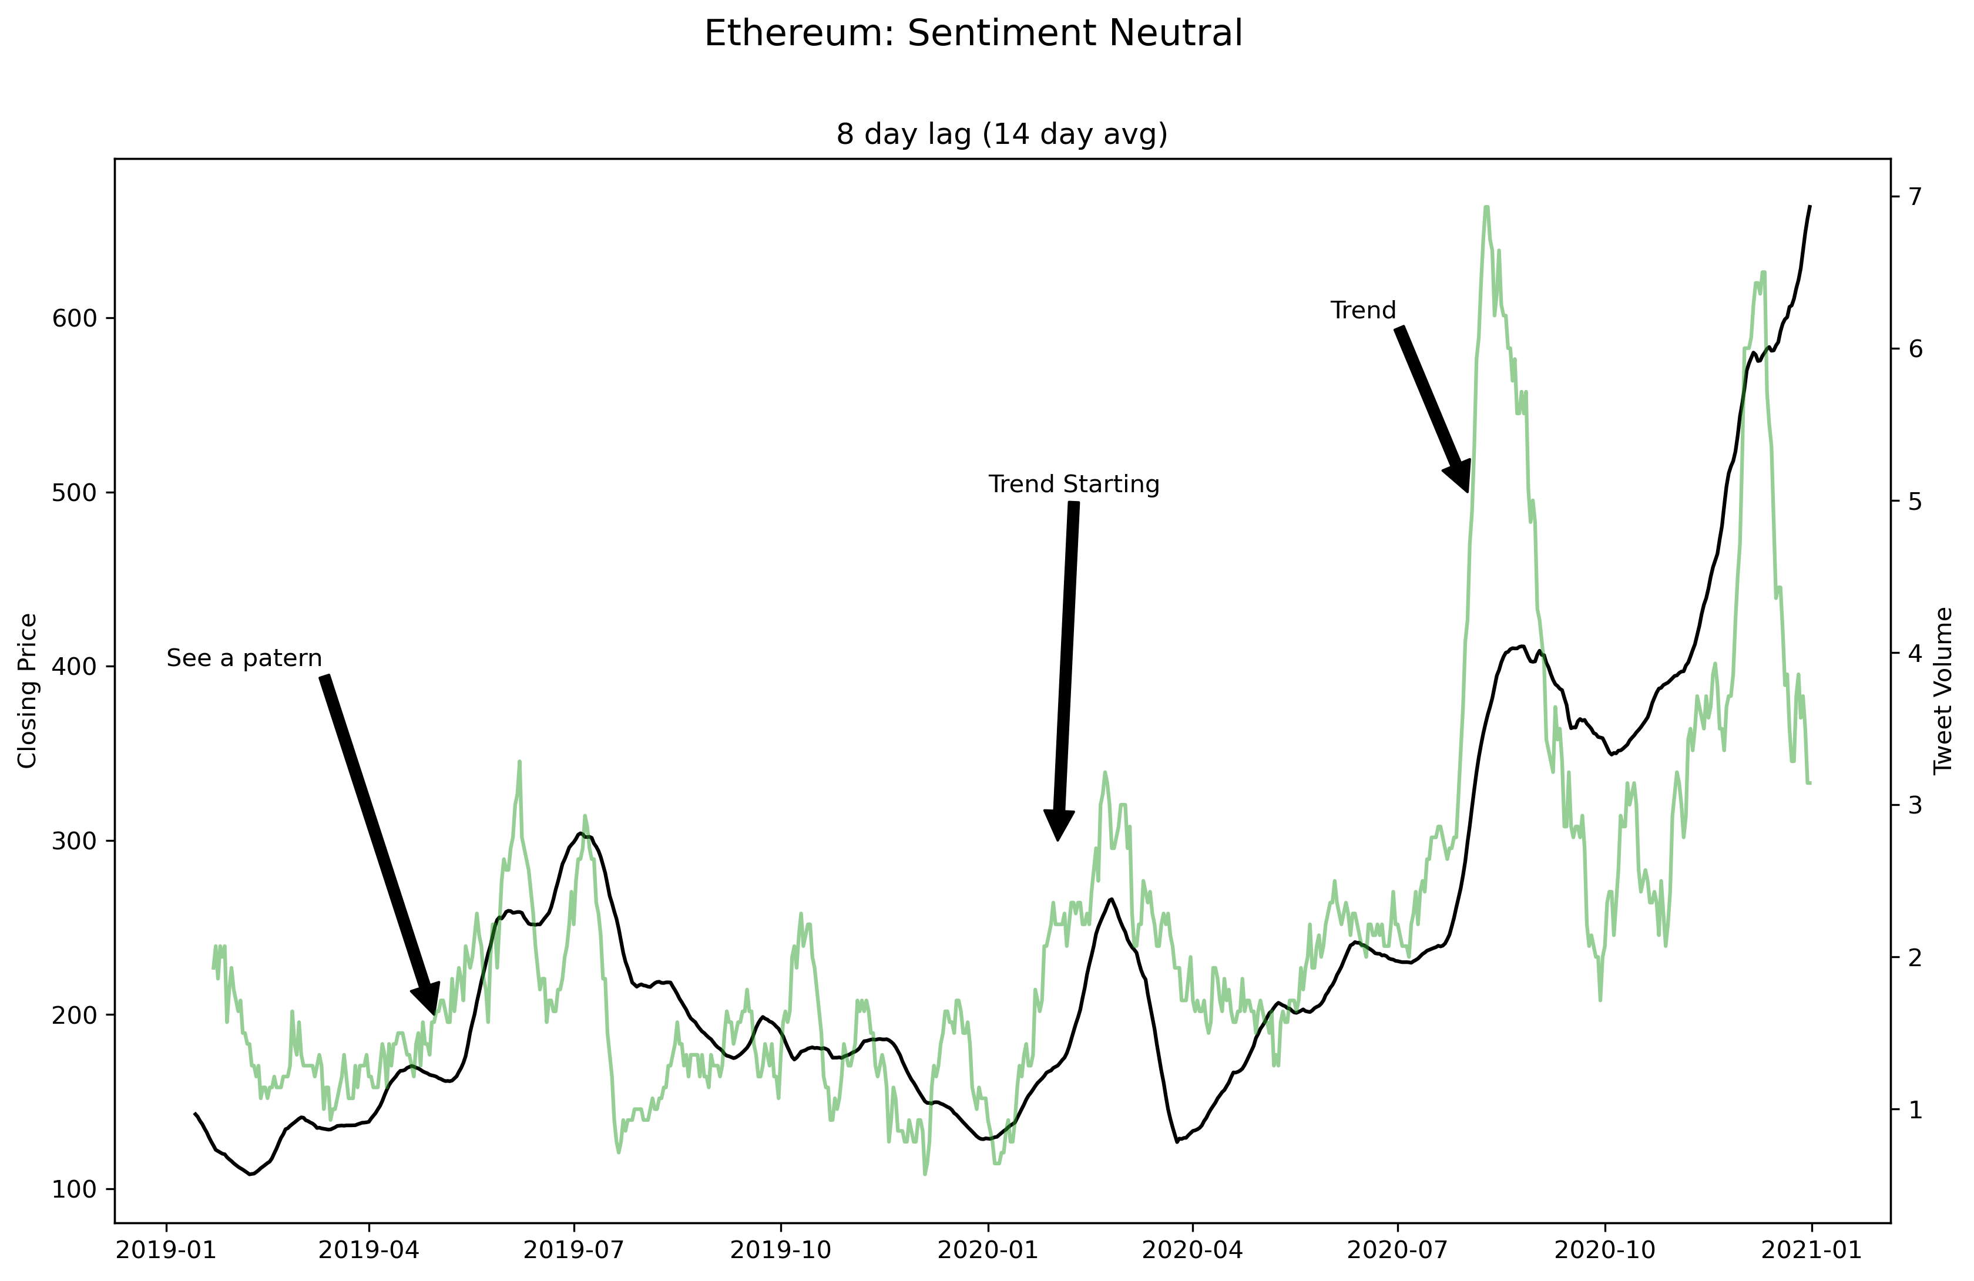

Slide 46
Discussion
Finding mean correlation coefficients for cryptocurrencies:
Mean of z-scores of r values
Convert mean z-score back to r value
Research Question 3 was not investigated with the intention of profiting from a global pandemic.
Twitter data had constant revision of the data to make sure it was clean

Slide 47
Conclusions
RQ1:
Cryptos seem to have limited influence on each other
Less so with a time lag
Daily prices
RQ2:
Long-term investment over short-term
Evaluation of short/long term trades

Slide 48
Conclusions
RQ3:
COVID-19 did not influence the share prices of cryptocurrencies.
Only looked at COVID deaths in the USA.
RQ4:
Social media can be used to spot trends
Scope & number of tweets

Slide 49
Does Crypto Pay Out?
Authors: Cillian Dunne, Eoghan McGlinchey and Aakrit Shrestha
Demonstrator: Eoghan Cunningham
Date: 30/04/2021

